Slide 1



Garbage Classification
By: Chinmay.R.Naregal

Slide 2

Learning Objectives
●Understand and implement transfer learning using pretrained models.
●Gain hands-on experience with the EfficientNetV2B2 architecture.
●Learn to preprocess and augment image data for better generalization.
●Train and validate a model on a multi-class garbage dataset.
●Analyze model performance using confusion matrix and classification report
●Contribute to environmental sustainability through AI-based waste management.
🎯 Goal
To develop an accurate and efficient garbage classification model using EfficientNetV2B2 and transfer learning for automated waste sorting.
GOAL

Slide 3
Tools and Technology used
🧠 Frameworks & Libraries
● TensorFlow – For building and training the deep learning model
● Keras – High-level API for creating the EfficientNetV2B2 model
● NumPy & Pandas – For data manipulation and analysis
● Matplotlib & Seaborn – For visualizing model performance
🖼️ Model & Architecture
● EfficientNetV2B2 – Pretrained Convolutional Neural Network used for transfer learning
● Transfer Learning – Reusing weights from pre-trained models to improve training efficiency
🧪 Development Tools
● VS Code – Local development environment
📁 Dataset Source
● Kaggle – Garbage Classification Dataset
–https://www.kaggle.com/datasets/farzadnekouei/trash-type-image-dataset
🔧 Supporting Tools
● Git & GitHub – Version control and project repository
● Gradio – For creating an interactive frontend to test the model

Slide 4
Methodology
🧩 1. Data Collection & Preparation
● Collected image data from a labeled Garbage Classification Dataset
● Performed train-validation split
● Applied image preprocessing: resizing, normalization
🧪 2. Data Augmentation
● Used Keras layers to apply:
● Random Flip
● Rotation
● Zoom
● Contrast adjustments
● Helps address class imbalance and improve generalization

Slide 5
🧠 3. Model Development
● Imported EfficientNetV2B2 pretrained on ImageNet
● Removed top layer and added custom Dense layers for classification
● Compiled model with:
● Loss Function: Categorical Crossentropy
● Optimizer: Adam
● Metrics: Accuracy
🚀 4. Training & Validation
● Trained the model for multiple epochs with validation set
● Monitored performance via training and validation accuracy/lo
📊 5. Evaluation
● Evaluated performance using:
● Confusion Matrix
● Classification Report
● Accuracy Scores

Slide 6
Problem Statement:
● Waste management is a major environmental challenge worldwide. Every day, tons of mixed waste are generated, and manual sorting of this waste is not only inefficient and labor-intensive but also prone to human error and health risks.
● One of the critical steps in effective waste management is accurate classification and segregation of garbage into categories like plastic, paper, metal, organic, glass, and others. However, the manual process is unsustainable, especially in densely populated areas.
● There is a pressing need for a smart, automated, and scalable solution that can classify waste accurately and in real-time.
● With the advancements in deep learning and computer vision, particularly using transfer learning techniques, we can develop an AI-based model that can automate this classification task with high accuracy.
● This project aims to solve this real-world problem by using EfficientNetV2B2, a powerful deep learning model, to build a garbage classification system that supports environmental sustainability and reduces human effort.
Source: UN Environment Programme, Research on Smart Waste Management, Kaggle Dataset

Slide 7
Solution:
Use of Transfer Learning: Implement EfficientNetV2B2, a powerful pretrained CNN model, to reduce training time and improve accuracy on the garbage classification task.
Automated Waste Classification: Train the model to accurately identify garbage categories like plastic, metal, glass, paper, organic, and others.
Data Augmentation Techniques: Apply techniques such as flipping, rotation, and zoom to overcome class imbalance and enhance model generalization.
Custom Classification Layers: Modify the top layers of EfficientNetV2B2 to adapt it for 6-class classification specific to the garbage dataset.
Model Evaluation: Use accuracy metrics, confusion matrix, and classification report to validate the performance.
Scalability and Real-world Use: Design the model to be deployable on smart bins, mobile devices, or web apps for real-time waste sorting applications.

Slide 8
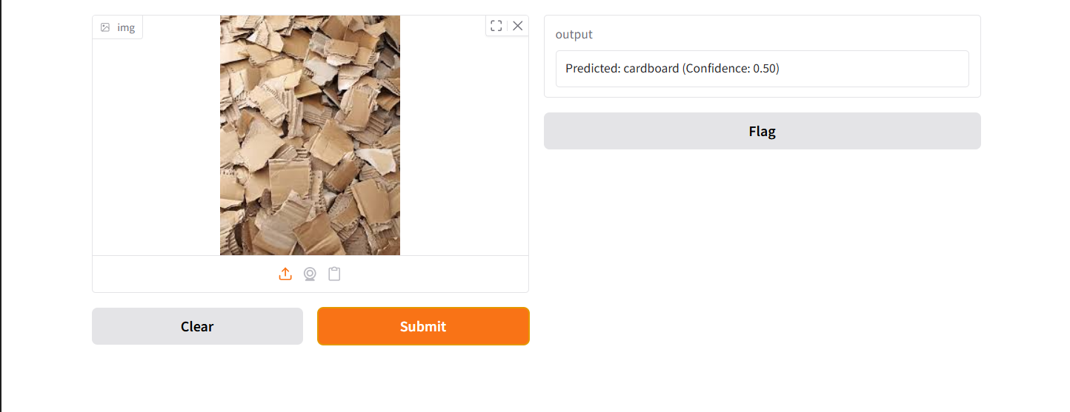
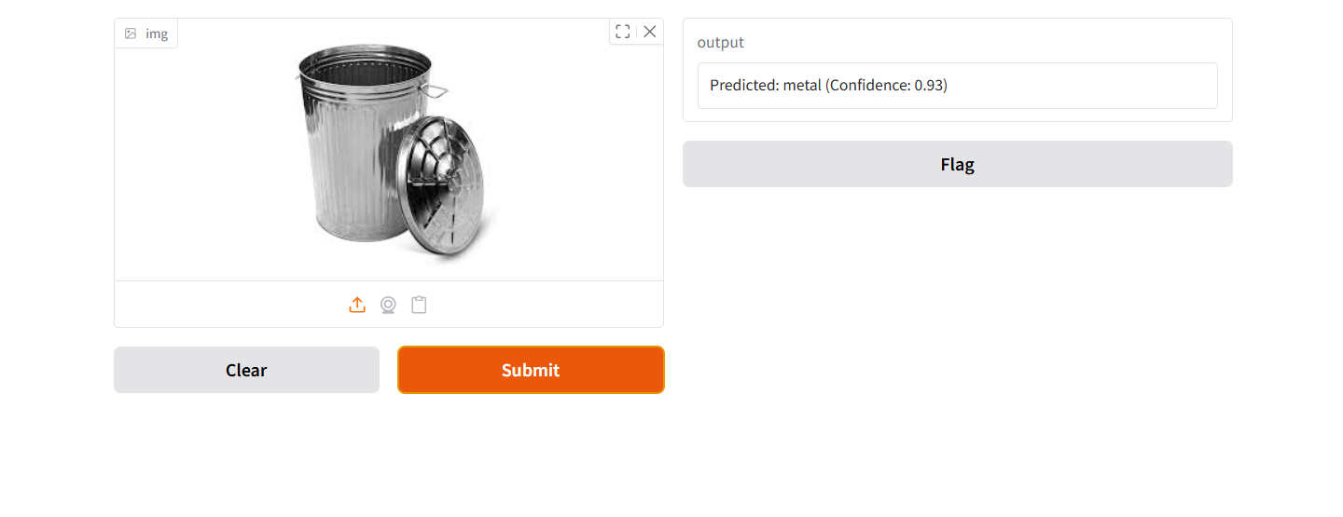
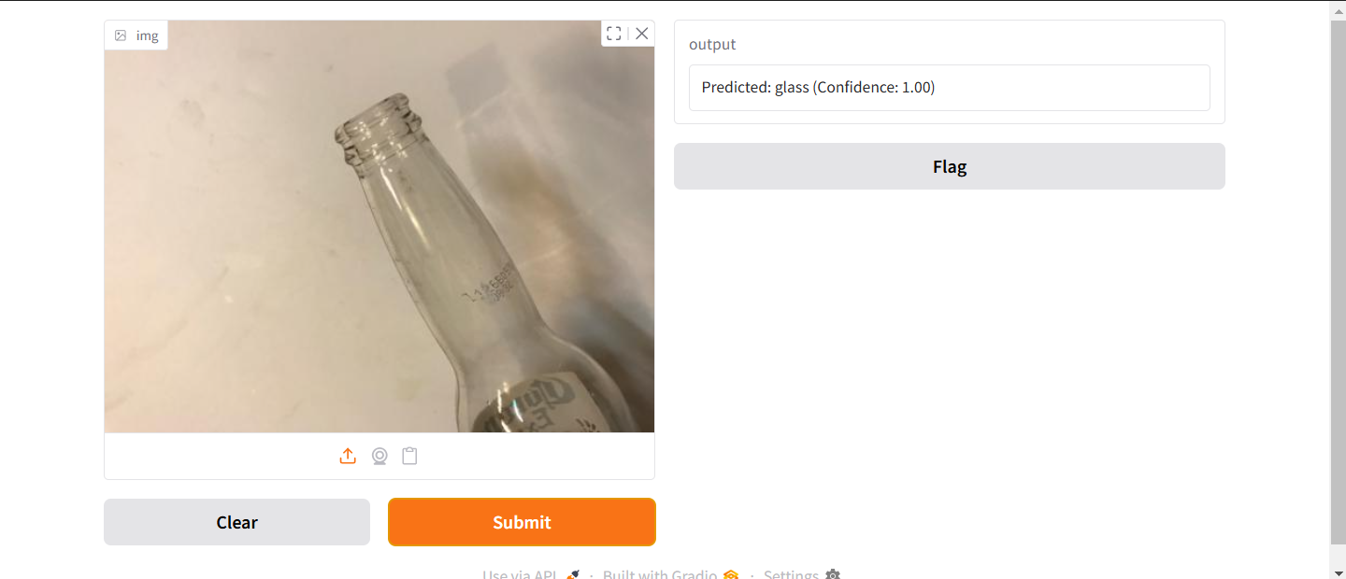
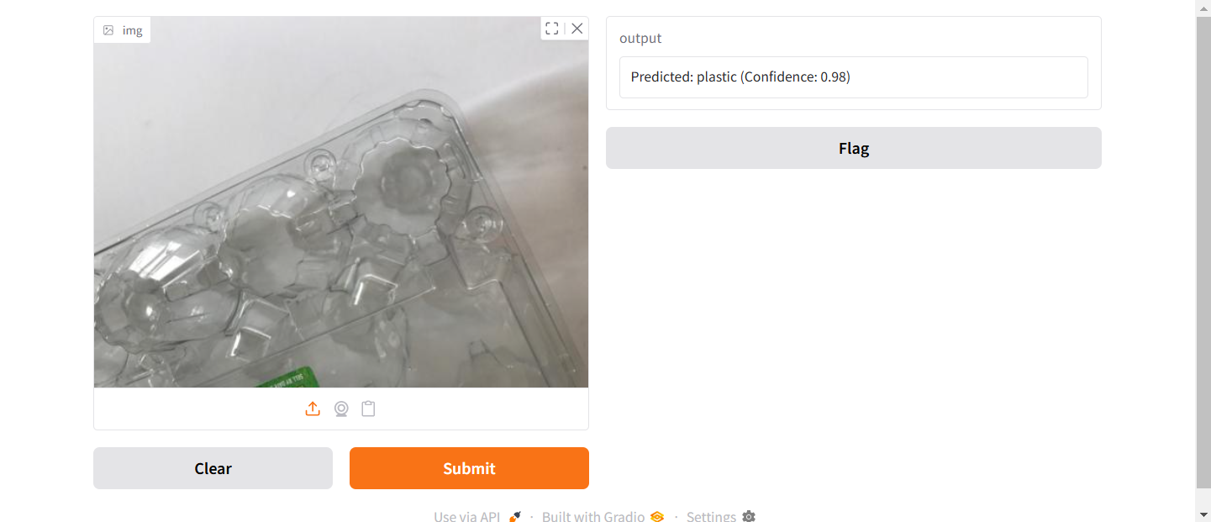

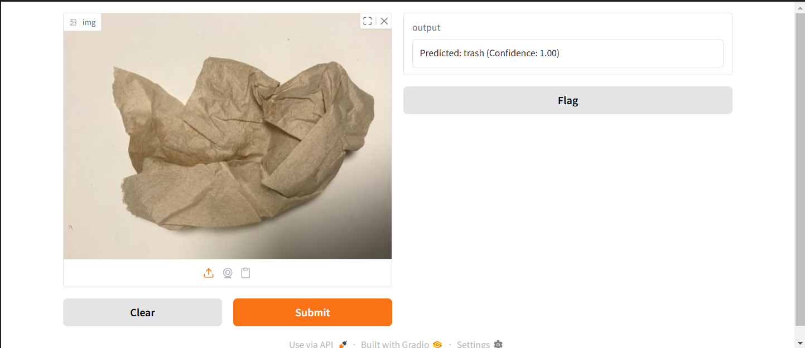
Screenshot of Output:

Slide 9
Conclusion:
● In this project, we successfully developed an AI-based garbage classification system using EfficientNetV2B2 and transfer learning.
● The model demonstrated good accuracy in identifying and classifying waste into six categories, helping address the challenge of automated waste segregation.
● This solution can significantly reduce manual effort, enhance recycling efficiency, and support sustainable environmental practices.
● With further improvements and deployment, it holds great potential for use in smart cities, municipal systems, and eco-friendly applications.

